Slide 1
Composers of the Western World
Choose an Era
Baroque
1600-1760
Classical
1750-1830
Romantic
1815-1910
20th Century
1900-2000

Slide 2
Baroque Composers
Antonio Vivaldi
Johann Sebastian Bach
George Frederic Handel

Slide 3
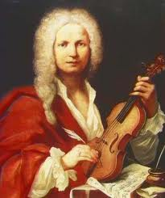

Antonio Vivaldi
1678-1741
Born: Venice, Italy
Best known for The Four Seasons
Composed mainly Concertos

Slide 4
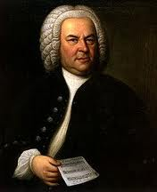
Johann Sebastian Bach
1685-1750
From Germany
Composed for:
  Organ
  Flute
  Harpsichord
  Chamber Groups
  Choirs

Slide 5
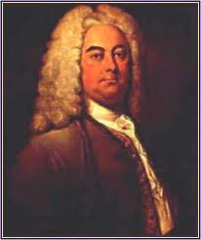
George Frideric Handel
1685-1759
Germany
42 Operas
29 Oratorios
120 Cantatas
Also Composed
  Sonatas
  Concertos
Most Famous: Messiah

Slide 6
Classical Composers
Joseph Haydn
Wolfgang Amadeus Mozart
Ludwig van Beethoven

Slide 7
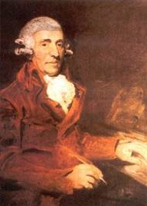
Joseph Haydn
1732-1809
Austria
Sometimes called “The Father of they Symphony, Father of the String Quartet
Composed:
    Sonatas
    Symphonies
    Chamber Music

Slide 8
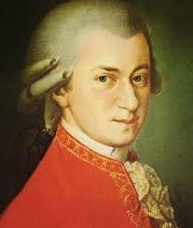
Wolfgang Amadeus Mozart
1756-1791
Austria
One of the most famous composers
Wrote over 600 works
  Many of which have variations such as “Twinkle Twinkle Little Star”

Slide 9
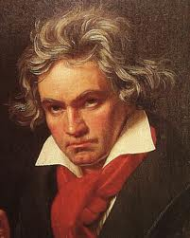
Ludwig Van Beethoven
1770-1827
Germany
Composed 9 Symphonies (the final symphony he was completely deaf)
Composed numerous Concertos
His works were the cross between the Classical period and Romantic period
Symphony #5 and Symphony #9 are his most famous

Slide 10
Romantic Composers
Antonin Dvorak
Pyotr Tchaikovsky
Richard Wagner

Slide 11
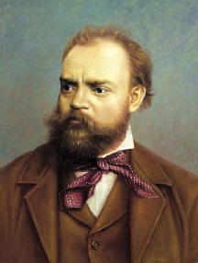
Antonin Dvorak
1841-1904
From Prague, now part of the Czech Republic
Composed 9 symphonies
Best known for his 2 Slavonic Dances

Slide 12
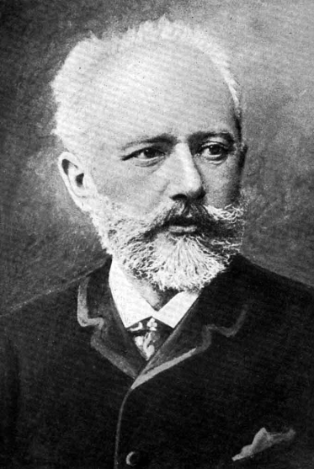
Pyotr Tchaikovsky
1840-1893
Russia
Famous for writing the following ballets:
  Swan Lake
  The Sleeping Beauty
  The Nutcracker
And
  1812 Overture

Slide 13
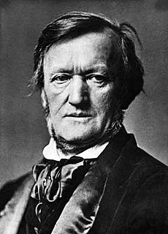
Richard Wagner
1813-1883
German Composer
Conductor, composer, theater director, and wrote many essays
Most famous composition is an opera titled Die Meistersinger von Nümberg.

Slide 14
20th Century Composers
John Philip Sousa
Claude Debussy
Igor Stravinksy

Slide 15
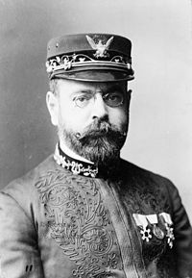
John Philip Sousa
1854-1932
American Composer
The King of Marches
Known for composing:
  The Stars and Stripes Forever
  The Washington Post March
  Semper Fidelis (The official march of the United States Marine Corp)

Slide 16
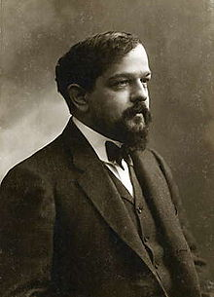
Claude Debussy
1862-1918
France
An impressionistic composer
Wrote mostly for Piano
Known for:
  Clair de Lune
  The Children’s Corner Suite

Slide 17
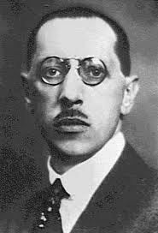
Igor Stravinsky
1882-1971
Russian
Composed:
  The Firebird Suite
  The Rite of Spring

Slide 18
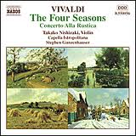
What are concertos?
A musical composition for one or more soloists. They typically have 3 movements, the first being fast, the second slow, and the final fast.

Slide 19
Symphony
A 4 movement work for a full orchestra. Usually the tempos of each movement change. Usually the first is a fast tempo, to slow, to medium fast, and finally vigorous or very fast.

Slide 20
Opera
A theatre performance that tells a dramatic story and is sung through out.

Slide 21

American Marches
Most were written for the military or the circus. Has 3 parts or “strains” The first and last strains are the same and the middle is usually slightly slower, has a key change, and is known as the “trio”

